Slide 1
Introduction to Financial Management
September 8th, 2022
Wenchen Wang

Slide 2
Learning Objectives
Term Definitions:
Financial Management
Accounting
Finance
Financial Management in the Public Service Organizations
Public Service Organizations Resource Flows
Governments
Health-care Services Industry
Non-profits
Notes:
One argument for this grouping is that these organizations, for the most part, are exempt from taxes
Their reason for existence. All these organizations are in the public service. As such, their major focus is to provide benefits to the community.

Slide 3
Financial Management Definition
The part of the management process that focuses on financial information that can be used to improve decision making.
For-profit
To maximize the wealth of the owners of the organization
Public, health, non-profit organizations
To achieve goals of the organization while maintaining a satisfactory financial situation
Notes:
Financial management is the subset of management that focuses on generating financial information that can be used to improve decision making.
In proprietary (privately owned and managed and run as a profit-making organization), or for-profit, organizations, the unifying goal of all decisions is to maximize the wealth of the owners of the organization.
In public service organizations—the term by which we may collectively refer to public, health, and not-for-profit organizations—the decisions are oriented toward achieving the various goals of the organization while maintaining a satisfactory financial situation.

Slide 4
Why Financial Management
Decisions
Earnings to achieve goals
Effectiveness
Efficiency
Profits
Safety margin
Replacement (equipment and facilities)
Expand services
Notes:
Now the question one may ask is that,
If public/health nonprofit organizations are not interested in wealth, why should they care about their financial situation?
Eg. For an org working for Homeless people – goal is to keep people from being hungry (place, staff, electricity)..
They have to Pay for that.
They have to manage their finances and balance their fundraising with expenses.
Decisions
How much will it cost to provide the meals? How much money can the organization expect to receive? From what sources? Are there adequate resources, or will there be a shortfall?
Effectiveness relates to whether an organization is accomplishing its mission. If there is a goal to feed 1,000 people per month, financial management can assess how effective the organization is in achieving that goal. How many people are in fact being fed?
Efficiency relates to whether the organization uses the minimum needed resources to produce its outcomes or outputs. To avoid wasting resources, organizations need to understand their productivity. How much did it cost per person fed? Is the organization maximizing the use of resources by finding the lowest-cost approach for achieving each of its results?
Profits
The profits are needed for safety. First, profits provide an organization with a safety margin. Things do not always go according to plan. If for some reason financial results are poorer than expected, a profit earned in a prior period can make up the shortfall.
Second, organizations must be able to replace their equipment and facilities over time as they wear out. If there is inflation, it will cost more to replace these items than they originally cost.
Third, organizations often want to be able to expand their services over time. This may be to reach out to more potential clients. Similarly, organizations want to be able to improve their services over time, perhaps taking advantage of new technologies. Some reasonable level of profits is necessary to allow for such expansions and adoptions of technologies.

Slide 5
Financial Management Components
The part of the management process that focuses on financial information that can be used to improve decision making.
Accounting
Finance (public finance)
Notes:
Financial management encompasses the broad areas of accounting and finance.

Slide 6
Financial Management
Accounting: Keeping track of the financial status
Managerial
Financial
Finance: The management of alternative sources and uses of resources within an organization
Loans
Financial Markets – Stocks & Bond Markets
Notes:
Accounting is a system for keeping track of the financial status of an organization and the financial results of its activities. It is often referred to as the language of business. The vocabulary used by accounting is the language of nonbusiness organizations as well. Governments, health-care organizations, and not-for-profit organizations often do not see themselves as being “in business.” Yet they must deal with many of the same financial issues as other types of organizations or risk “going out of business.” Receivables, payables, inventory, net assets, depreciation, and debt are just a few of the accounting terms that managers of public service organizations encounter in their interactions with the organization’s financial managers.
Finance focuses on the alternative sources and uses of the organization’s financial resources. Obtaining funds when needed from appropriate sources and the deployment of resources within the organization fall under this heading. In addition, finance involves the financial markets (such as stock and bond markets) that provide a means to generating funds for organizations.

Slide 7
Accounting
Managerial accounting
The generation of financial information for planning and decision making
Create financial plans
Implementation
Work towards achieving those plans
Financial accounting
A system for tracking and reporting the resources owned and used by an organization
Summarize data
Specific point in time
Reports to interested stakeholders
Notes:
Managerial:
Some examples of managerial accounting include preparing annual operating budgets, generating information for use in making major investment decisions, and providing the data needed to decide whether to buy or lease a major piece of equipment.
Financial
Financial accounting provides retrospective information. As events that have financial implications occur, they are recorded by the financial accounting system. From time to time (usually monthly, quarterly, or annually), the recorded data are summarized and reported to interested users. The users include both internal managers and people outside the organization. Those outsiders include those who have lent or might lend money to the organization (creditors), those who might sell things to the organization (suppliers or vendors), those who might seek the organization’s services (e.g., clients or patients), and other interested parties. These interested parties may include regulators, legislators, and citizens. Financial statements provide information on the financial status of the organization at a specific point in time, in addition to reporting the past results of the organization’s operations (i.e., how well it has done from a financial perspective).

Slide 8
Government Organizations
Includes federal, state, and local governments
Combined governmental spending in US is approximately $6 trillion per year
Revenue sources and use
Funds are provided by taxes, service fees, and intergovernmental transfers
Funds are used to provide public services
Notes:
Intergovernmental grants: from one level to another

Slide 9
Government Organizations
Government | Revenues | Expenditures
Federal | Individual income tax, social insurance tax | Social Security, defense, income security, health care
State | Sales tax / Individual income tax | Education, Infrastructure
Local | Property tax / Charge for services | Public safety, transportation and utilities
Notes:
Federal revenues: individual income taxes (47%), social insurance taxes (the majority of which are Social Security taxes) (38%), and corporation income taxes (6%) [% are 2020]
FEDERAL EXPENDITURES: (% are 2020)
social security (24%)
national defense (15%)
Income security: welfare (services to elderly and people with disabilities) and food stamps (12%)
Health (13%)
Medicare (15%)

Slide 10
Government Organizations
Includes federal, state, and local governments
Combined governmental spending is approximately $6 trillion per year
Funds are provided by taxes, service fees, and intergovernmental transfers
Funds are used to provide public services
Differences between receipts (resource inflows) and expenditures (resource outflows) are surpluses (>0) or deficits (<0)

Slide 11
Federal Budget (2018)
Revenues: $3.33 trillion
Expenditures: $ 4.11 trillion
Surplus or deficit?
Deficit $0.78 trillion
Notes:
Expenditures:
social security
national defense
Income security: welfare (services to elderly and people with disabilities) and food stamps

Slide 12
Federal Deficit History
Office of Management and Budgeting. Table 1
Notes:
What happens when the federal gov. is short of resources? Debt
What happens if the deficit persists? DEBT increases
How tax cuts affect the budget deficit?
Foreign governments and investors hold 29% of it
Biggest portion: China and Japan far: UK and Brazil
Intragovernmental holdings – held by Social Security, Military Retirement Fund, Medicare, and other retirement funds.
The 2001 recession reduced tax revenues due to higher unemployment and lower corporate profits. Large tax cuts in 2001 and 2003, a post-9/11 expansion in homeland security operations, and new defense spending for wars in Afghanistan and Iraq all contributed to growth in the national debt, as did a major expansion of the Medicare program in 2006 (providing coverage for pharmaceuticals). In addition, countercyclical fiscal policies following the so-called Great Recession that spanned the end of 2007 through the middle of 2009—namely, direct government financial assistance to for-profit companies, investment in national infrastructure, a temporary cut in federal payroll taxes, and an extension to federal unemployment benefits—further exacerbated the nation’s debt load.
In 2020, the deficit has reached a new high level due to covid-19.
Off-budget is the revenue and spending of certain federal entities.
Off-budget government spending is excluded from budget caps, sequestration, and pay-as-you-go requirements.
The two federal entities that are off-budget are the Social Security Trust Fund and the U.S. Postal Service.
The surplus and deficits shown in Table 1-3 are on-budget and off-budget items combined. Off-budget surpluses are being used to offset on-budget spending. This allows the government to report a lower deficit or a higher surplus. However, when the federal government uses social insurance trust funds (off-budget money) to offset the deficit, it must borrow them from the Social Security trust fund, increasing the overall level of the national debt.

Slide 13
Government Organizations
Government | Revenues | Expenditures
Federal | Individual income tax, social insurance tax | Social Security, defense, income security, health care
State | Sales tax / Individual income tax | Education, Infrastructure
Local | Property tax / Charge for services | Public safety, transportation and utilities
Notes:
STATE
Revenue: another significant source of funds for state and local governments is the federal government. Other receipts include taxes on motor vehicles, various fees, other taxes, and miscellaneous revenues.
State and local governments rely on each of these sources to varying degrees, and not all state and local governments have the same mix. For example, local governments tend to rely heavily on property taxes, whereas state governments do not. Also, not all states have income taxes on individuals or on businesses, nor do all states have sales taxes.
Education: K-12
Infrastructure: Transportation

Slide 14
Revenues in Minnesota
2018-2019 Biennium
$83,306 Million Revenues
2019 Feb. Forecast
Notes:
Non-taxable sales tax such as clothing in MN

Slide 15
Expenditures in Minnesota
2018-2019 Biennium
$83,306 Million Revenues
2018-19 Biennium
$ 83,042 Million Spending
2019 Feb. Forecast
Notes:
DEFICIT????
Since state and local governments, unlike the federal government, generally are not allowed to run a deficit

Slide 16
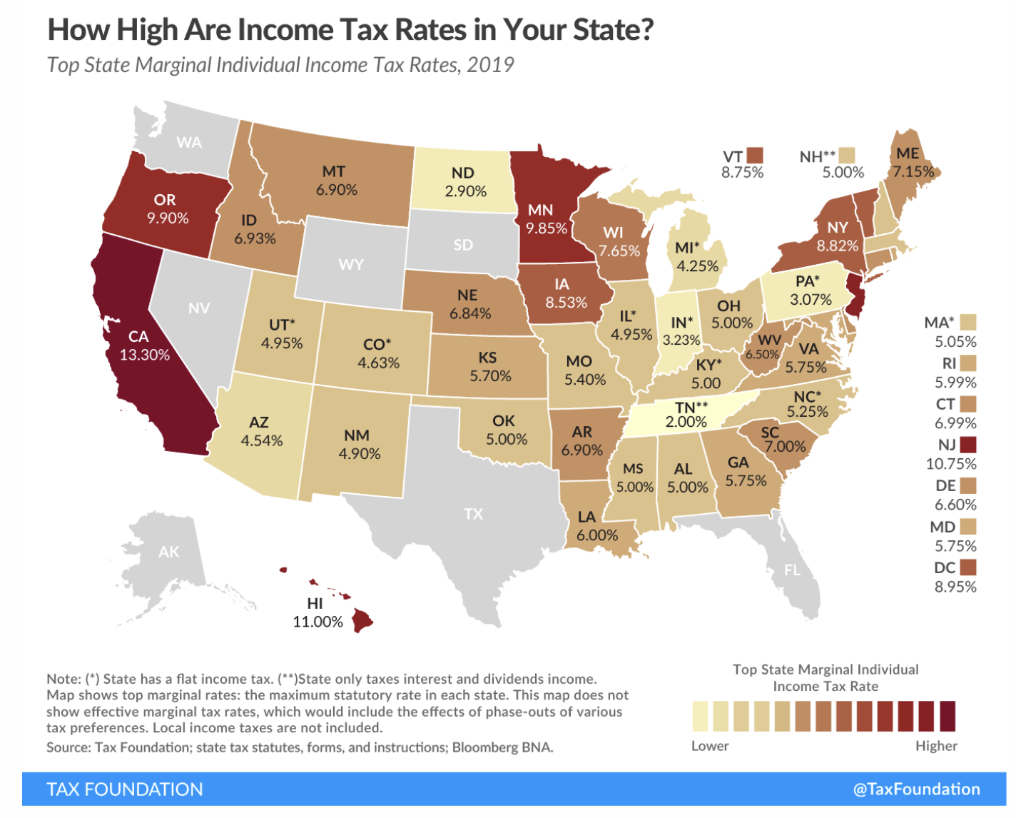
Notes:
No income tax in florida, Texas, wyoming

Slide 17


Slide 18
COVID’s Impact
States incurred significant costs due to COVID
At the same time, state and local governments experienced precipitous declines in revenues.
The impact of COVID resulted in significant reductions in spending in other areas.
Notes:
Cost: related to unemployment insurance claims, providing COVID testing, providing health-care services, modifying air ventilation systems, creating safe school environments, etc.
Revenues: restaurant, hotel occupancy, and sales tax revenues, and smaller decreases in personal and small business income tax revenues.
Cutbacks in services such as public transportation and higher education were particularly severe.
Though the federal Coronavirus Aid, Relief, and Economic Security (CARES) Act of 2020 offset some of these expenses, the extent to which it did so remains to be seen.

Slide 19
Health Care Organizations
Include both for-profit and not-for-profit organizations
Total health care spending is $3.5 trillion in 2017
About 20% of GDP
Government pays for just under half of all health care costs with the remainder paid by insurance companies and other private sources
More than half of health dollars go to pay for hospital care and physicians and clinical services
Notes:
In 1965, federal legislation was passed creating Medicare and Medicaid. Since then, spending on health care has risen at a rapid rate. Medicare is a federal program; Medicaid and other public programs are paid for by federal, state, and local governments
2019:
Medicare (21%)
Medicaid (16%)
Private insurance (31%)
Out-of-pocket (11%)
Investment (5%)
Other (16%)

Slide 20
Nation’s Health Dollar (2017) - Revenues
Notes:
Government pays for just under half of all health care costs with the remainder paid by insurance companies and other private sources
DOD department of defense

Slide 21
Nation’s Health Dollar (2017) - Expenditures
Notes:
Although COVID clearly stressed the health-care system, with hospitals treating hundreds of thousands, if not millions of COVID patients, and at times running out of critical care beds, with hundreds of millions of doses of vaccine purchased and administered, and other costs incurred, overall health-care spending did not necessarily rise as a result of COVID. Much routine health-care spending was deferred during the pandemic. In fact, health-care “spending for the first ten months of 2020 was 2.3 percent lower than in the first ten months of 2019

Slide 22
Nonprofit Organizations
There are more than 1.5 million nonprofit organizations registered in the U.S. (National Center for Charitable Statistics)
Public charities (70%), private foundations, chambers of commerce, fraternal organizations and civil leagues
Compose 5.4 percent of the country’s GDP
Are exempt from most forms of taxation at the federal, state, and local level
Notes:
Non profits: art, health, education, and advocacy nonprofits; labor unions; and business and professional associations.
Public charities (1.1 million): arts, culture, and humanities organizations; education organizations; health care organizations; human services organizations;

Slide 23
Nonprofit Organizations
Revenues: Come from donations, grants, contracts for services, or the sale of good and services
Expenditures: Operations and capital improvements

Slide 24
Contributions to NFP Organizations by Source, 2013
Notes:
Revenues: Come from donations, grants, contracts for services, and the sale of good and services
Expenditures: Operations and capital improvements
How do not-for-profit organizations obtain donations and grants? Fundraising has become an important part of the job of managers of not-for-profit organizations. There are two major types of fundraising: contributions or donations, and contracts or grants. The funds that not-for-profit organizations receive from these sources are either with or without donor restrictions. The organization may use funds without donor restrictions for any valid organizational purpose. If the funds have donor restrictions, however, the organization must comply with specific limitations on how the funds may be used.
Tax deductions for donating to NFP organizations
- What happens if the government decide to take away those deductions? How will that affect these organizations?

Slide 25
Contributions to NFP Organizations by Type of Recipient Organization, 2013
Financial Management For Public, Health, And Not-For-Profit Organizations, 5th Ed. © Sage CQ 2016

